Slide 1

IT 582 - Summer 2018 Physical Computing The Internet of “Things” Week 3
Check off Assignment 2
Digital Vs. Analog Signals
If-then-else
Switch Case
Use Output window as input
David Macaulay

Slide 2

Physical Computing – IT582

Slide 3
Physical Computing – IT582
SO FAR ….
Until now, our sketches have been using digital electrical signals,
with just two discrete levels
We used digitalWrite(pin, HIGH) and
digitalWrite(pin, LOW) to blink an LED
And we used digitalRead() to measure whether a digital pin
had a voltage applied to it (HIGH) or not (LOW).
What is a visualization of these levels??

Slide 4
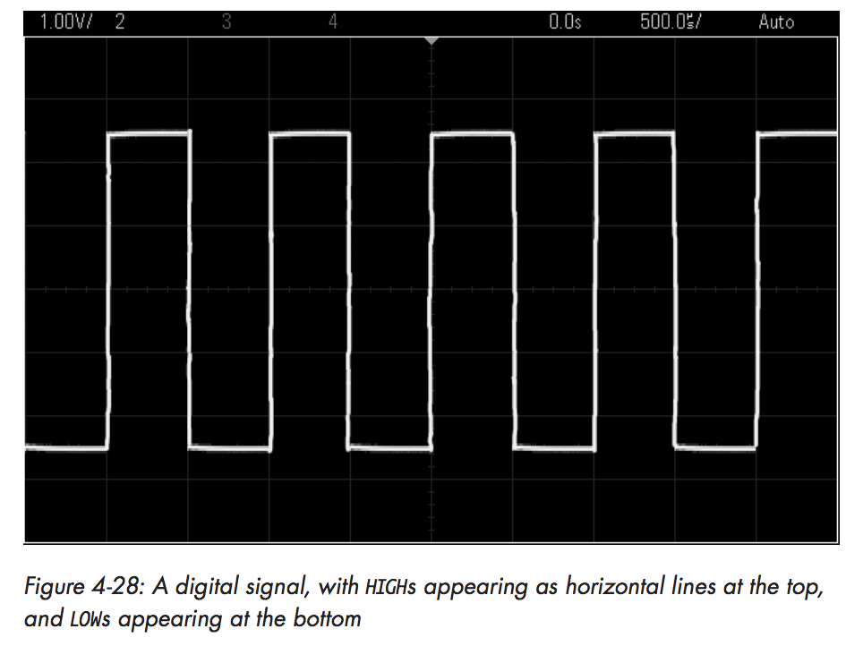
Physical Computing – IT582

Slide 5
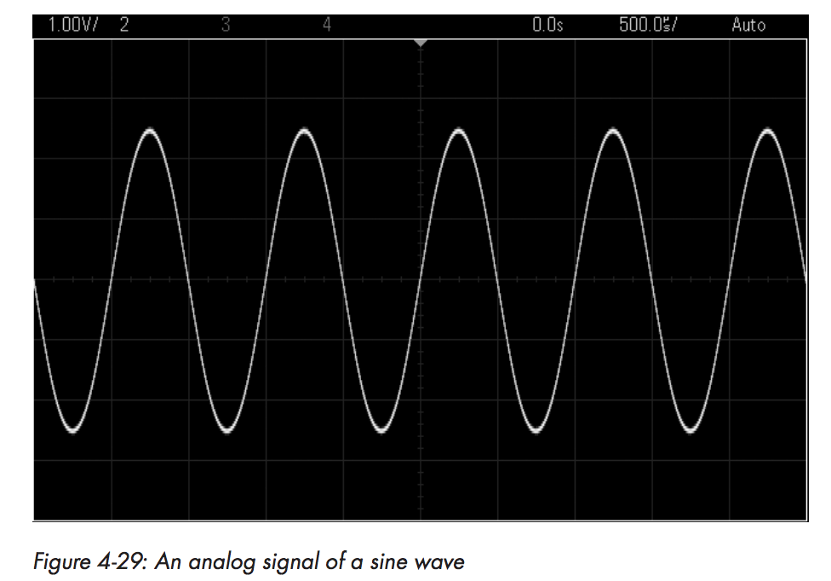
Physical Computing – IT582
- Unlike digital signals, analog signals can vary with an indefinite number of steps between high and low.
For example, Figure 4-29 shows an analog signal of a sine wave.
Notice in the figure that as time progresses, the voltage moves fluidly between high and low levels.

Slide 6
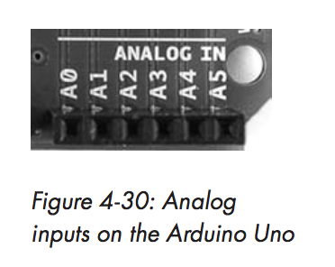
Physical Computing – IT582
- We can’t measure analog signals like digital … but we can check values of an analog signal with our Arduino using the six analog inputs shown in Figure 4-30.
These analog inputs can safely measure voltages from 0 (GND) to no more than 5 V.
Unlike digital signals, analog signals can vary with an indefinite number of steps between high and low.

Slide 7
Physical Computing – IT582
- If you use the function analogRead(), then the Arduino will return a
number between 0 and 1,023 in proportion to the voltage applied to the pin..
For example, you might use analogRead() to store the value of analog pin zero in the integer variable a:
a = analogRead(0); // read analog input pin 0 (A0)
// returns 0 to 1023, usually 0.000 to 4.995 volts

Slide 8
Physical Computing – IF
- We’ve used the IF statement to compare two values and ACT on the
comparison:
if ( digitalRead(BUTTON) == HIGH )
{ digitalWrite(LED, HIGH); }
else
{ digitalWrite(LED, LOW); } }

Slide 9
Physical Computing – Switch - case
- To compare two or more variables, it’s better to use a switch-case statement
instead of an if-then statement – much cleaner!!
- Switch-Case statements can make an indefinite number of comparisons and run code when the comparison is found to be true.
- For example, if we had the integer variable xx with a possible value
of 1, 2, or 3 and we wanted to run certain code based on whether a value was
1, 2, or 3, then we could use code like the following to replace an if-then
statement:

Slide 10
Physical Computing – IT582
- switch(xx)
{
case 1: // do something as the value of xx is 1
…
…
break; // finish and move on with sketch
case 2: // do something as the value of xx is 2
…
break;
case 3: // do something as the value of xx is 3
…
break;
default: // do something if xx is not 1, 2 or 3 // default is optional
} // EXIT here

Slide 11
Physical Computing – IT582
USING THE OUTPUT WINDOW ..for input.
Serial.begin(9600); // initialize serial port (We’ve done this)
Serial.flush(); //Using Serial input – clean out anything in there!
Serial.println("Type '1' in Output window for Battery check, '2’ for Alarm circuit; ");
if (Serial.available() ) // If a character has been typed from keyboard
//START Serial Read if -- control Arduino from keyboard !!!
{
char ch = Serial.read(); //READ it in !!

Slide 12
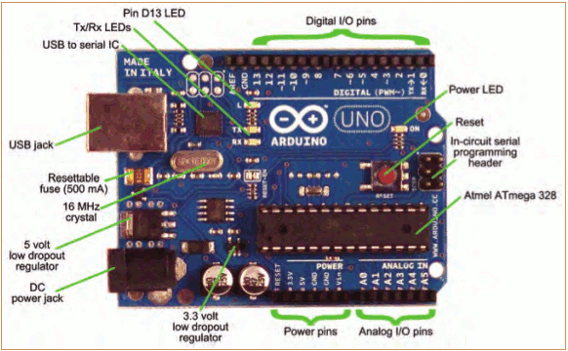
Physical Computing – IT582
BUT only from 0 up to +5 volts!!

Slide 13
Physical Computing – IT582
USING the analogread() function …
To capture the voltage on analog pin 0 and put it
into variable “a” like this:
a = analogread (0)
Here is how this function works: it will RETURN an
integer from 0 to 1023 in proportion to the voltage on
pin 0.
So, we need to convert this integer into voltage. Since
the most it can read is +5 volts … Arduino splits
5 volts into 1024 “pieces”. What would each piece’s
value be??

Slide 14
Physical Computing – IT582
Right – 0.0048 volts, or more correctly, 4.8 mv or
MILLI volts.
For instance --- if analogread (0) returns 512, the voltage
it is seeing is 512 X 0.0048 or 2.4576 volts
…..we’re going to use this property to build a battery checker …
Historical precedent …

Slide 15

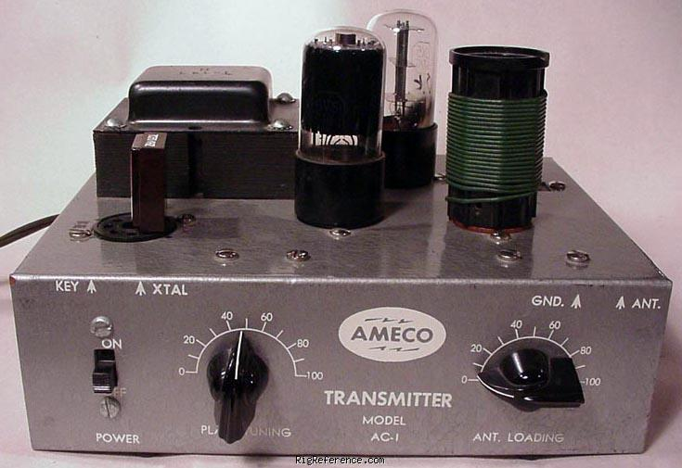

Slide 16
Physical Computing – IT582
Next assn – build a battery checker … Here is our algorithm:
Read from analog pin 0 and convert to voltage value.
If the voltage is >= 1.6 volts, blink a GREEN LED for 1Sec
If the voltage is 1.6 > v > 1.4, blink a YELLOW LED for 1Sec
If the voltage is <= 1.4 volts, blink a RED LED for 1Sec
*** Note TURN LED off for ½ second !!! (Why)
REPEAT indefinitely
Assignment 3 PART 1 -- Go ahead and write the program to do this –
hardware sketch is on the next page…. DEMONSTRATE with 0 volts,
5 volts, and a AA battery…

Slide 17
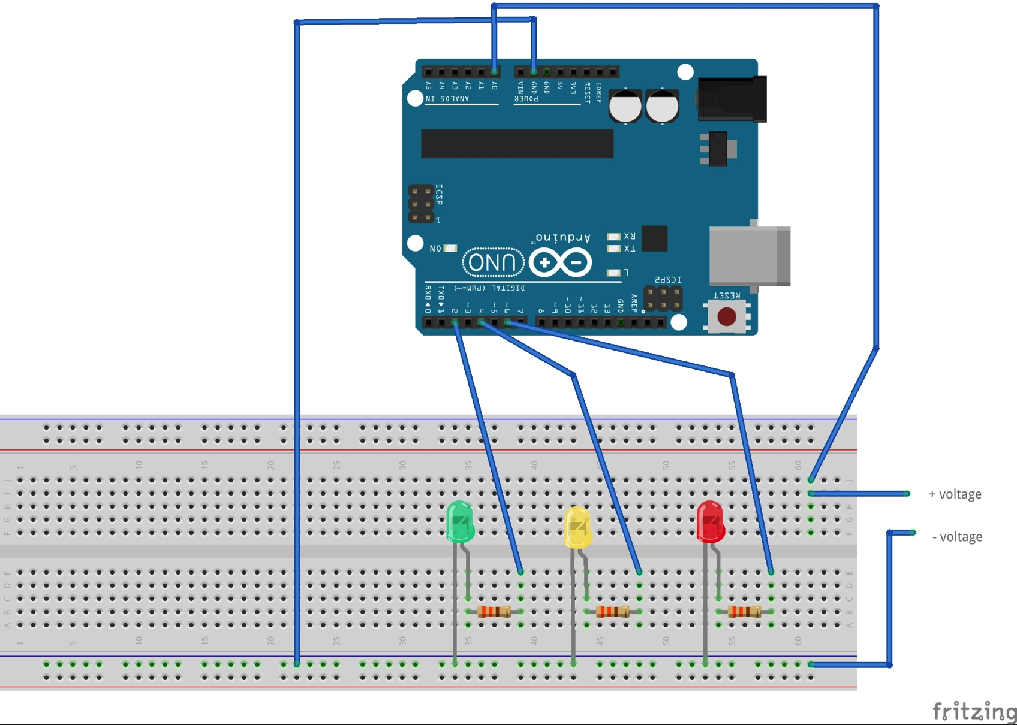
Physical Computing – IT582
BUILD this Single Cell Battery tester with this diagram!!
WARNING !! DON’T measure
anything > 5 volts!!
AND watch POLARITY ! You
can damage ARDUINO!
Test by probing Ground,
+5 volts, and a 1.5 volt battery

Slide 18
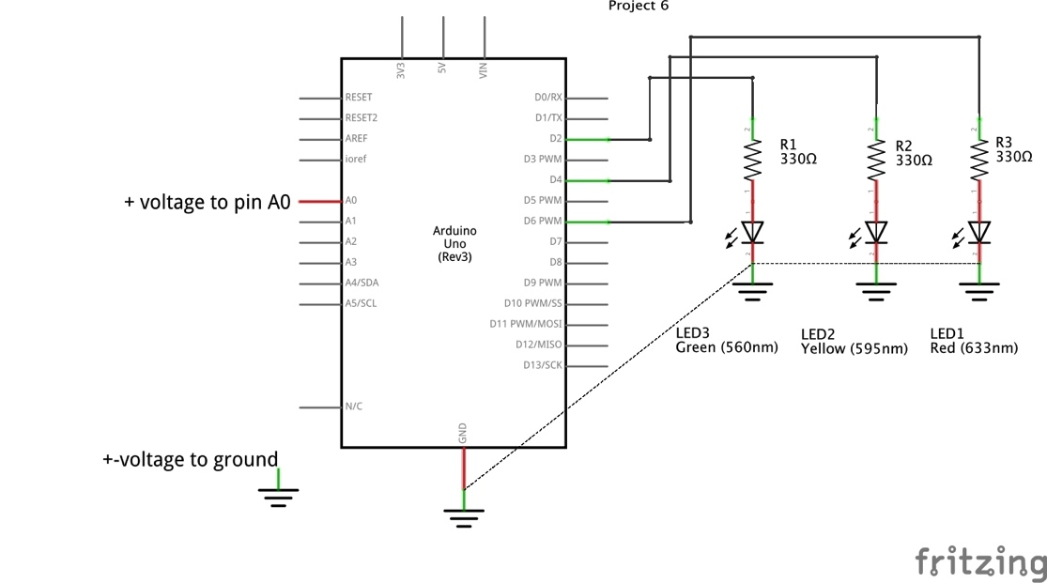
Physical Computing – IT582
Single Cell Battery tester
WARNING !! DON’T measure
anything > 5 volts!!
AND watch POLARITY ! You
can damage ARDUINO!

Slide 19
Physical Computing – IT582
Assignment 3 PART 2
ADD to your sketch the following:
1) READ a choice in from the keyboard
2) USE switch-case choose either
battery checker for choice 1 or an
alarm for choice 2 that just sounds your
piezo buzzer (2) times for 1 second on 1 second off…
Note these are not in the Blackboard Image or schematic!!
Serial.println("Type '1' in Output window for Battery check, '2’ for Alarm circuit; ");

Slide 20
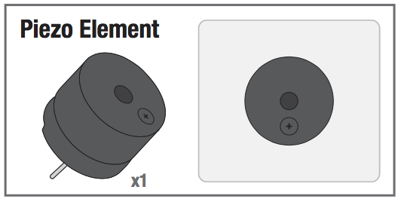
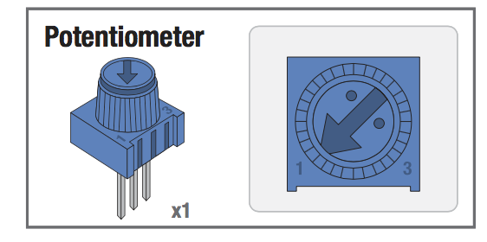
Physical Computing – IT582
Assignment 3 PART 2
SEE circuit 2A page 38 in your SIK book … hook PIEZO up just like an
LED …
SUGGESTION – Connect your 10K pot (5 v and 0 V on sides)
And use the middle pin as a variable voltage to check out sketch!!!

Slide 21
Physical Computing – IT582
Assignment 3 PART 2
Is this experiment just contrived???
WHEN WOULD I EVER WANT TO USE AN ALARM LIKE THIS??

Slide 22

Physical Computing – IT582
Do Quiz # 1 on blackboard !!!

